Slide 1
Smart Agriculture system
Syed zia Uddin

Slide 2
OBJECTIVE:
The objective of this project is to automate daily task performed by farmer through the use of mobile robot. Each mobile robot will comprise of following features;
  Mobile robots equipped with sensors and actuators (emulated)
  Each mobile robot act as a IoT robot, that sends telemetry data and receive user commands over a network.

Slide 3
PROJECT FEATURES
Distributed architecture used (microservice).
Deployed using docker container.
MQTT protocol for backend services , HTTP protocol for front end
Scalable, modular and portable

Slide 4
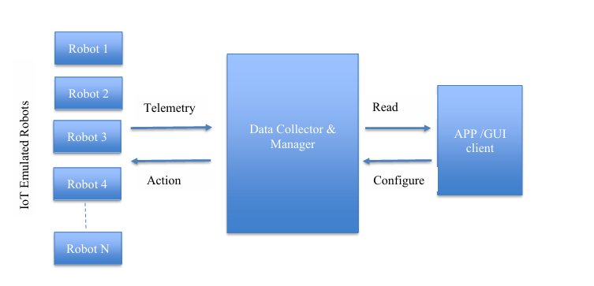
GENERAL BLOCK DIAGRAM.

Slide 5
DESIGN ARCHITECTURE

Slide 6
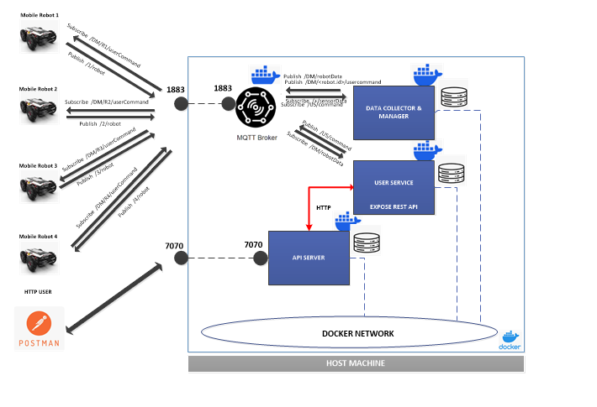

Slide 7
DESIGN ARCHITECTURE - COMPONENTS
IoT Mobile Robots:
  Mobile robot encapsulate all the sensors and actuators (emulated).
  Publishes robot telemetry data for data manager
  Subscribed to receive user command via data manager & collector.
  MQTT Protocol used , QoS : 1 (Pub) ,QoS : 2 (Subs) , Data format: JSON
Data Manager & Collector:
  It is subscribed to receive robot telemetry data.
  It Publishes the robot telemetry data for user service.
  It is subscribed to receive user command via user service
  It publishes the user command for IoT robot based on Robot id.
  In memory storage ,MQTT Protocol , QoS: 1 & 2 enabled, deployed using Docker

Slide 8
DESIGN ARCHITECTURE – COMPONENTS…..(Cont’d)
3. User service:
  Act as a bridge between data manager/collector & Api server.
  It is subscribed to receive robot telemetry from data manager via MQTT protocol and expose this data via HTTP to Api server.
  Receives User command via HTTP from Api server and publish it for data manager via MQTT Protocol
  MQTT Protocol & HTTP used, in memory data storage , QoS : 1 & 2 enabled , Data format: JSON , deployed using Docker.
4. Api Server:
  Use to start HTTP service for Api User. Use resource RobotDataResource to send telemetry data to Api user.
  Use resource , RobotCommandResource , to send api user data to user service.

Slide 9
DESIGN ARCHITECTURE – COMPONENTS…..(Cont’d)
5. MQTT Broker.
  Eclipse Mosquito broker image version 2.0.12 is used, which is officially available on docker hub.

Slide 10
RUN & TEST:
Each IoT mobile robot script is run in python ide.
All the other services are deployed through docker container and run via docker compose.
Postman is used for user interaction, GET method is used to receive robot telemetry data
POST method is used to send user commands. (start ,stop , configure)

Slide 11
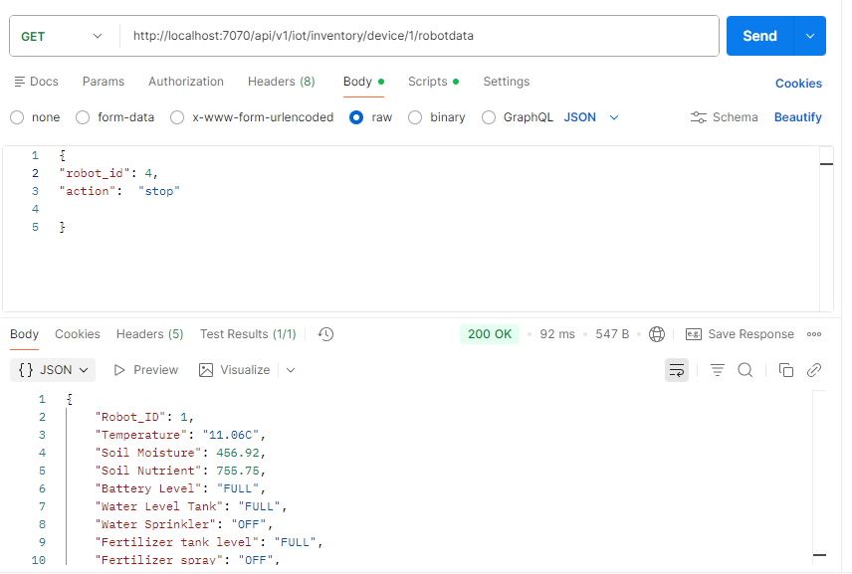

Slide 12
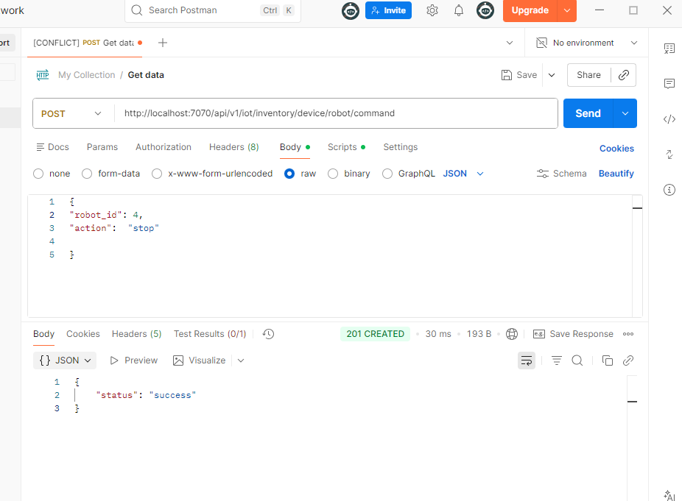

Slide 13
Thank You

